Slide 1

Research Project Plan 2020-2021
Chanthan HEL
Lecturer/Researcher
Department of Telecommunications and Networking Engineering,
Institute of Technology of Cambodia
chanthan@itc.edu.kh
https://github.com/Chanthan89/Smart-Irrigation
http://gee.itc.edu.kh

Slide 2
Active members
Researcher
Dr. Pec Rothna
Dr. Nget Rithea
Dr. Ket Pinnara
Mr. Tep Sovichea
Mr. Chhorn Sopheaktra
Mr. Hel Chanthan
Students (Under Mr. Chanthan’s supervision)
Sai Thavat (I5)
Vannak Sovannroth (I4)
Nhim Chanrengsey (I4)
Proeung Bunrong (I4)
Chek Nita (I4)
Sokha Sokheng (I4)
Bin Chanthy (I4)

Slide 3
Project Involved
[HEIP]-Toward Production Innovation via Fablab-ITC (Co-PI)
[HEIP-Under Reviewed]-Integrated approach of precise irrigation and sustainable Soil management to improve crop water productivity in Cambodia through ITC soil laboratory development: the focus on rice farming (Member)
[LBE-JICA]-Development of Control and Monitoring System for Efficient Cultivation and Growing Modeling of Mushroom in Cambodia (Co-PI)
[LBE-JICA]-Implementation of Data Transmission Testbed Focused on Channel Access Protocol Design with Physical-layer Network Coding for Low Latency Transmission (Member)
[ARES-CCD]-Establishment of an Automatic Real-Time Monitoring System for Irrigation Water Quality Management (Member)

Slide 4
Focused Area
1. Online-Automatic irrigation/data collection system
WSN/Module for open space/Large farm (Monitoring and control of environmental and soil data)
Manual and auto mode
Online control/command
Store data in open platform
(Thinspeak by Mathworks)
Free platform hosted in
Local server (Ignition by
Inductive automation)
Self Backend- Frontend
design

Slide 5
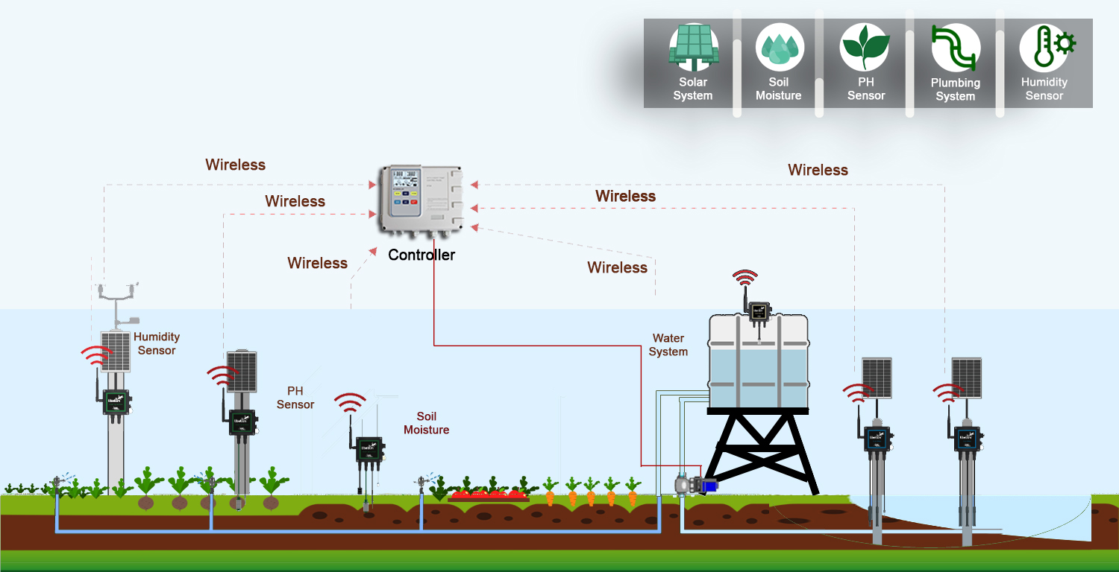
Focused Area
2. Offline-Automatic irrigation and data collection system
WSN/Module for open space/Large farm (Monitoring and control of environmental and soil data)
HMI control and
display
SD storage
Medium and long
Range (Xbee, Lora)
Plug and play
Solar powered
Open sources
Hardware and
Industrial hardware

Slide 6
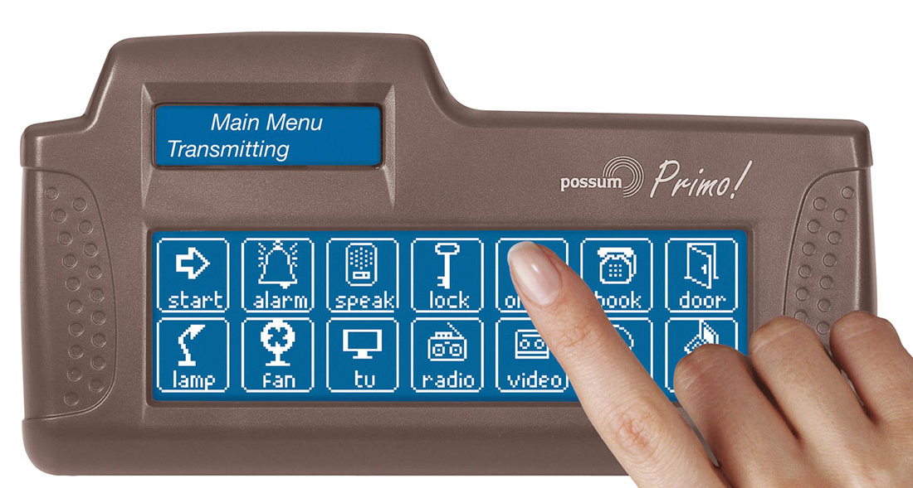
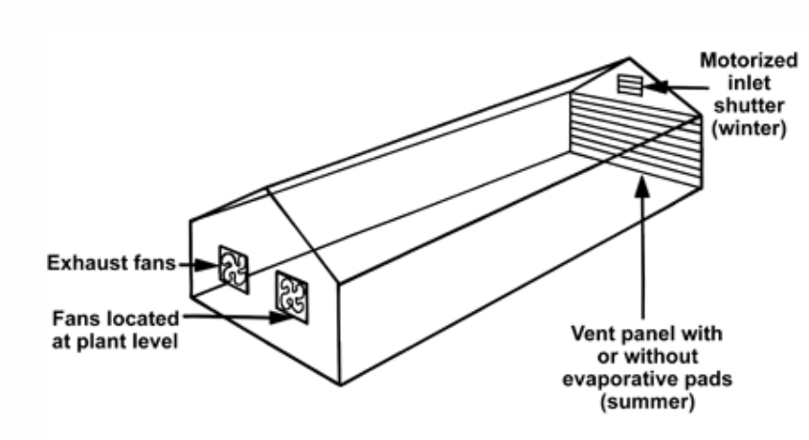
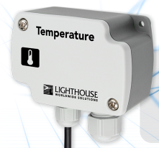
Focused Area
3. Plug and Play-On/Offline-Greenhouse Environmental monitoring and control Module
Output
Input

Slide 7
Focused Area
4. Multi purpose tester for agriculture
Soil moisture/Temperature
Soil/water pH
Ambient temperature/Humidity
Nutrient
…..........

Slide 8
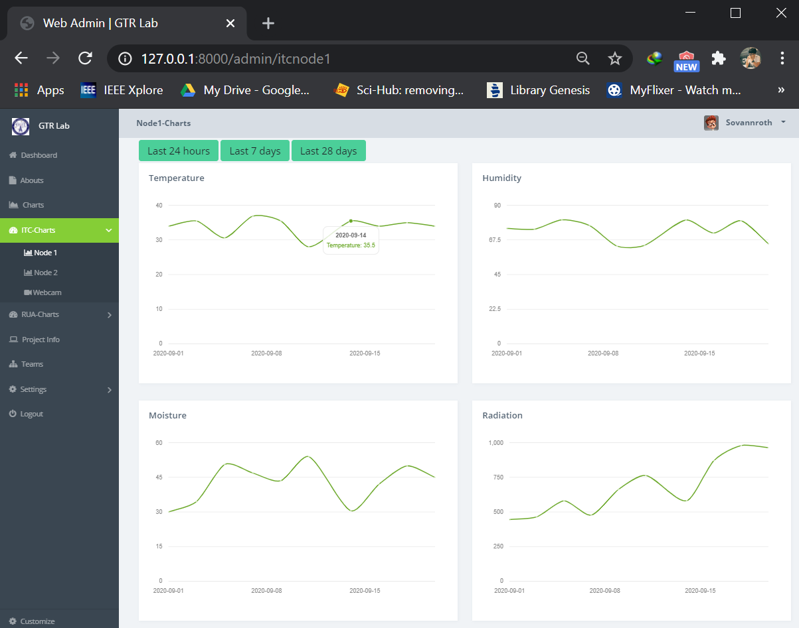
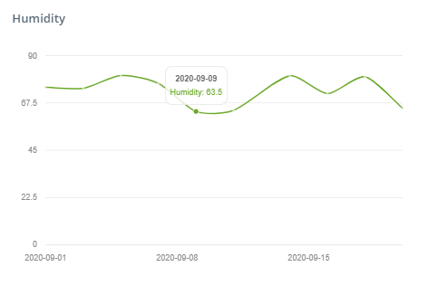
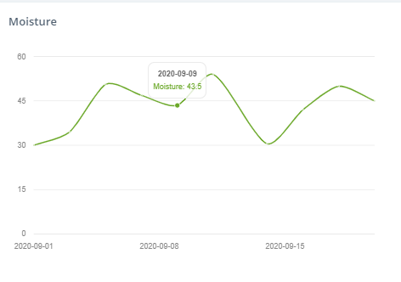
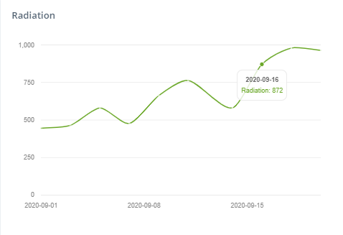
Focused Area
5. Farm’s data storage, monitoring and analytics:
Backend: Server, Database
Frontend development: Web application and mobile application
Data analytic of the farm environment using machine learning/AI technique

Slide 9
Ongoing Project Progress

Slide 10
Online-Automatic irrigation/data collection system
Bunrong and Thavath (Co-Supervise: Vichea, Pheaktra, Dr. Pinnara)
Project: Establishment of an Automatic Real-Time Monitoring System for Irrigation Water Quality Management (ARES-CCD)

Slide 11
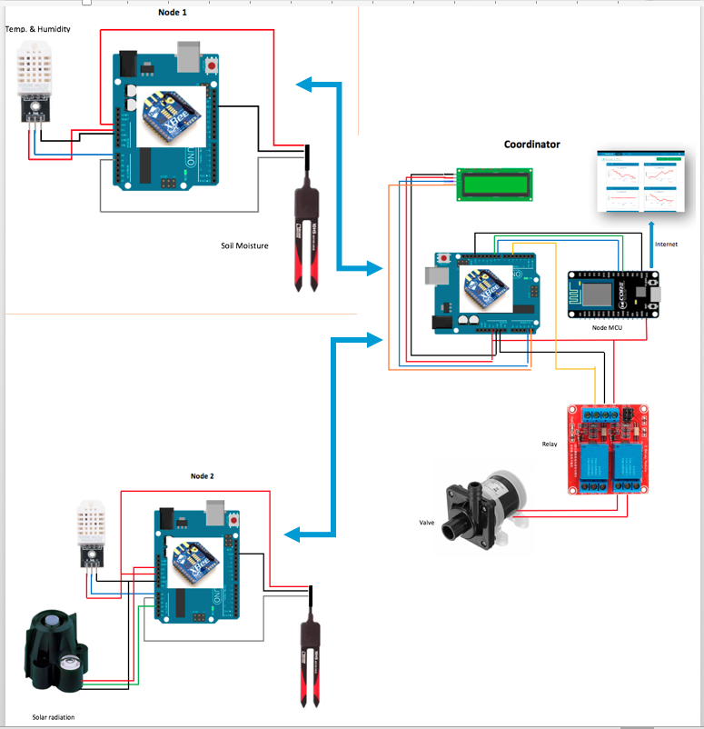
https://thingspeak.com/channels/1111041

Slide 12
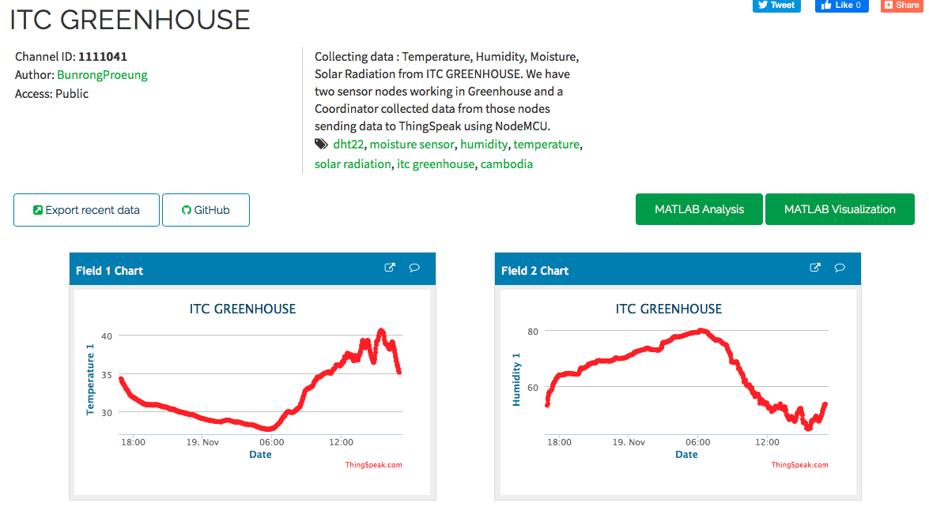
https://thingspeak.com/channels/1111041

Slide 13
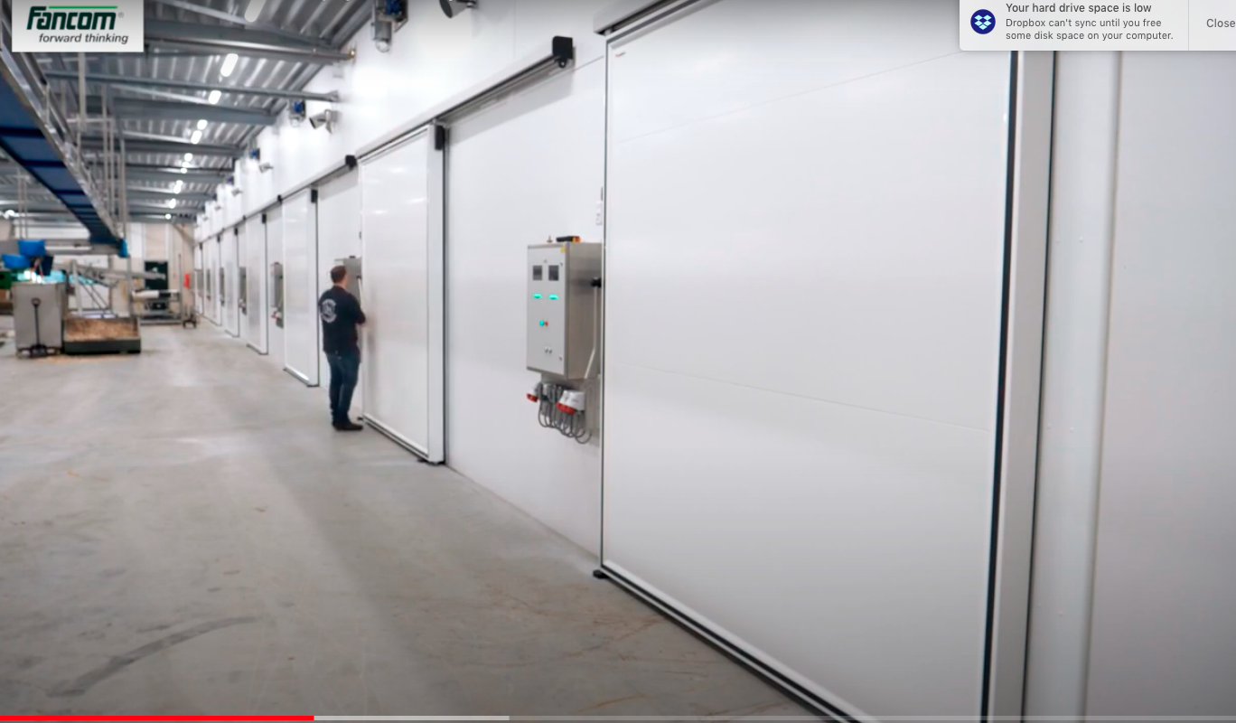
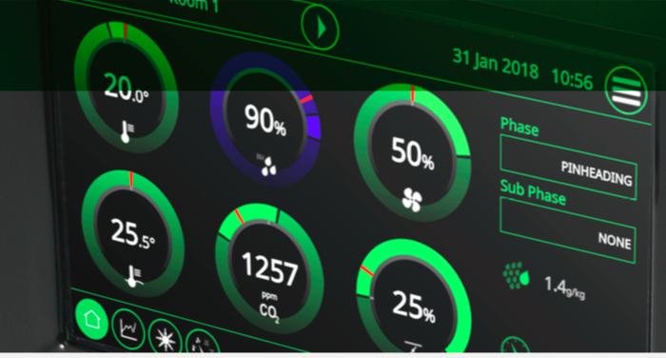
Online-Automatic irrigation/data collection system
Rengsey, Chanthy,….., (Lead by : Tep Sovichea)
Project: Development of Control and Monitoring System for Efficient Cultivation and Growing Modeling of Mushroom in Cambodia (LBE)
Develop Control and Monitoring System
Mushroom Growing Model

Slide 14
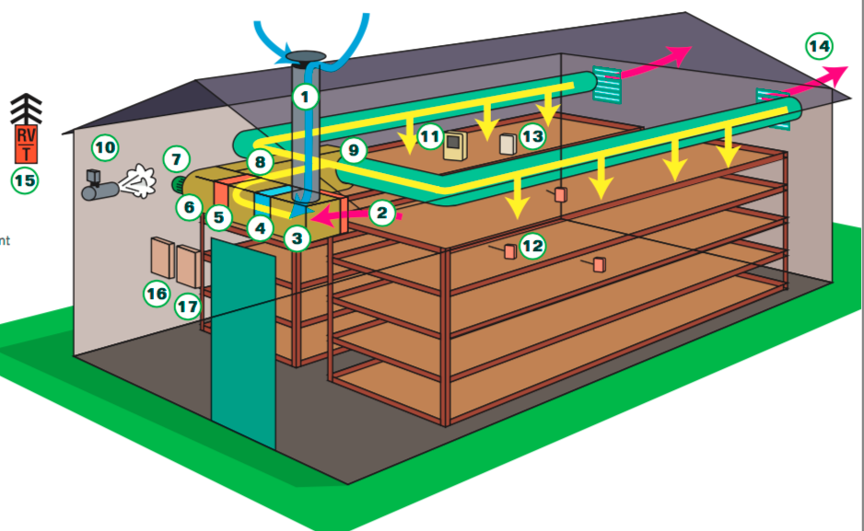
http://iot-lab.itc.edu.kh/data/perspective/client/MushAuto
Control
-CO2
-Temp
-Humi.
-Lighting
-Ventilation

Slide 15
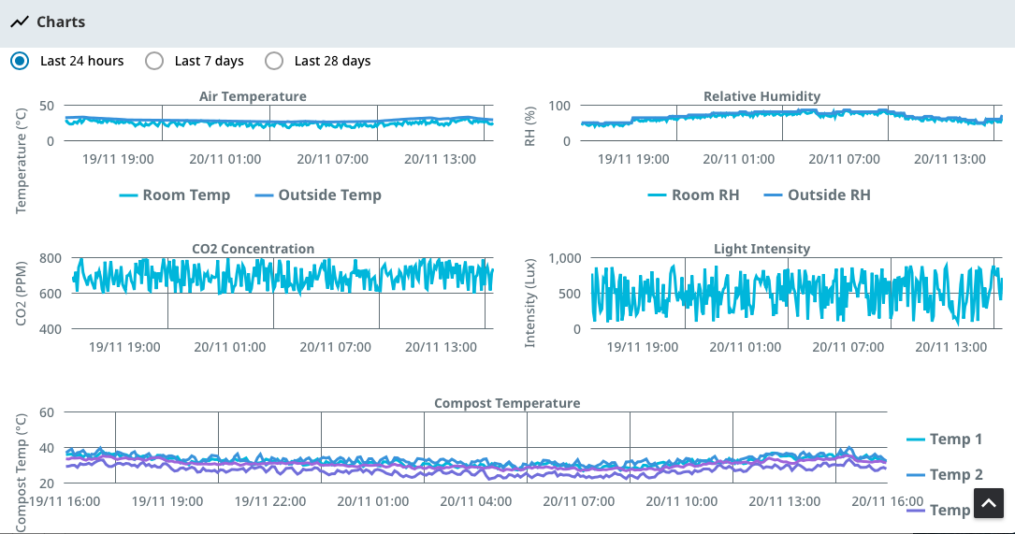
http://iot-lab.itc.edu.kh/data/perspective/client/MushAuto

Slide 16
Multi purpose tester for agriculture
Rengsey (Co-Supervise: Pheaktra)
Smart farming project (Fab-Lab, HEIP)

Slide 17
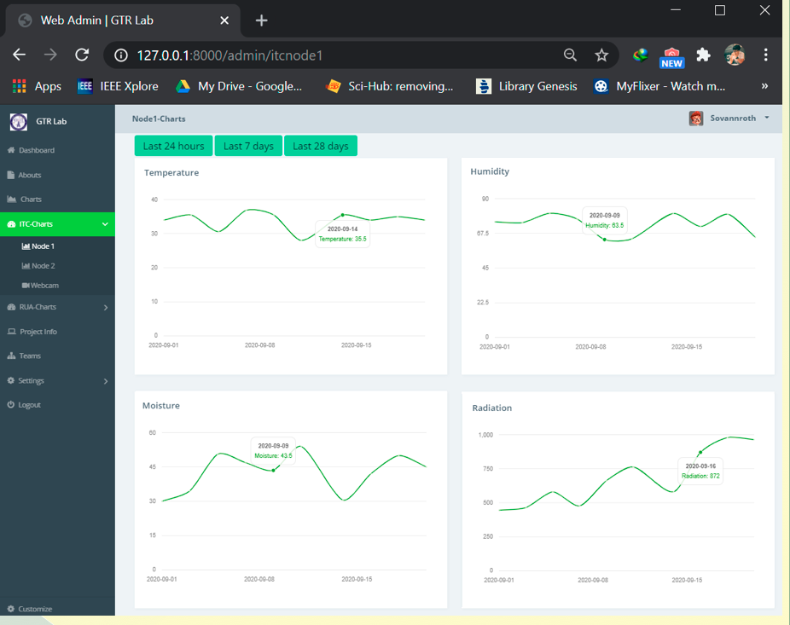
IoT Cloud Storage
Sovannroth (Co-Supervise: Daraly)
Project: Smart farming project (Fab-Lab, HEIP)
- Laravel framework
Bootstrap
Flutter

Slide 18
Data analytic (Beginner)
Nita: Start working on Image process and Machine learning

Slide 19
Thanks

